Slide 1
Cooking App and Responsive Website
Leila ghanbarinejad

Slide 2
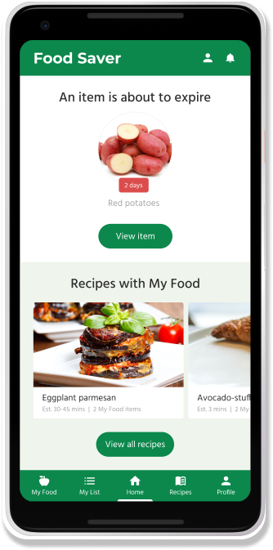
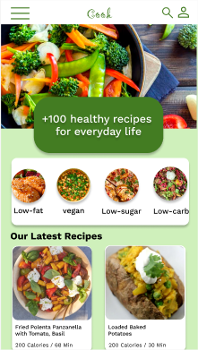
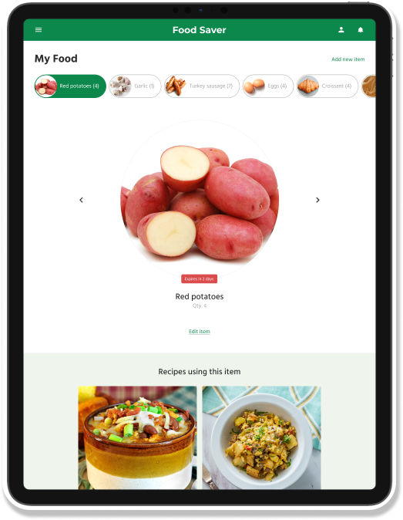
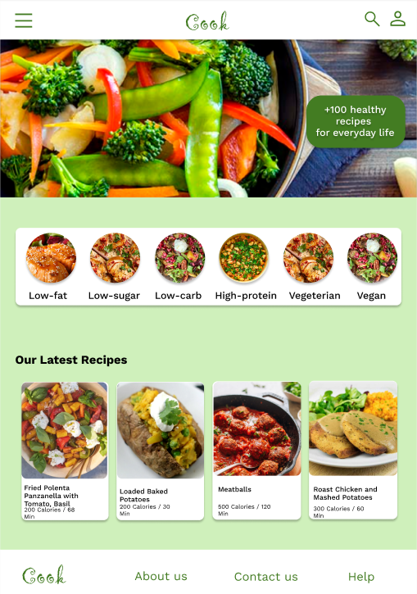
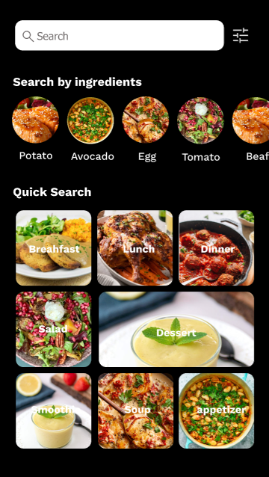
Project overview
The product:
We need a tool that helps people learn how to cook healthier meals. Our primary target users include college students and adults who are concerned with their health and would like to learn more about what they can do to have healthier lives.
Project duration:
May 2022 to July 2022

Slide 3
Project overview
The problem:
These days many people suffer from diseases, even in young ages because of unhealthy lifestyle and foods they eat. We found out that many of them do not know about various kinds of recipes that can help them eat healthier meals.
The goal:
Design an app that will provide different kinds of recipes for different groups of people with various kinds of diets and restrictions and help them choose their suitable meals.

Slide 4
Project overview
My role:
UX designer leading the app and responsive website design from conception to delivery
Responsibilities:
Conducting interviews, paper and digital wireframing, low and high-fidelity prototyping, conducting usability studies, accounting for accessibility, iterating on designs, determining information architecture, and responsive design.

Slide 5
User research
Personas
Problem statements
Competitive audit
Ideation
Understanding
the user

Slide 6
User research: summary
After conducting user interviews, we found out that most interview participants reported feeling badly about the kinds of food they eat, but they didn’t actively try to cook healthier meals. The feedback received through research made it very clear that users would be open and willing to work towards learning healthy recipes if they had access to an easy-to-use tool to help guide them.

Slide 7
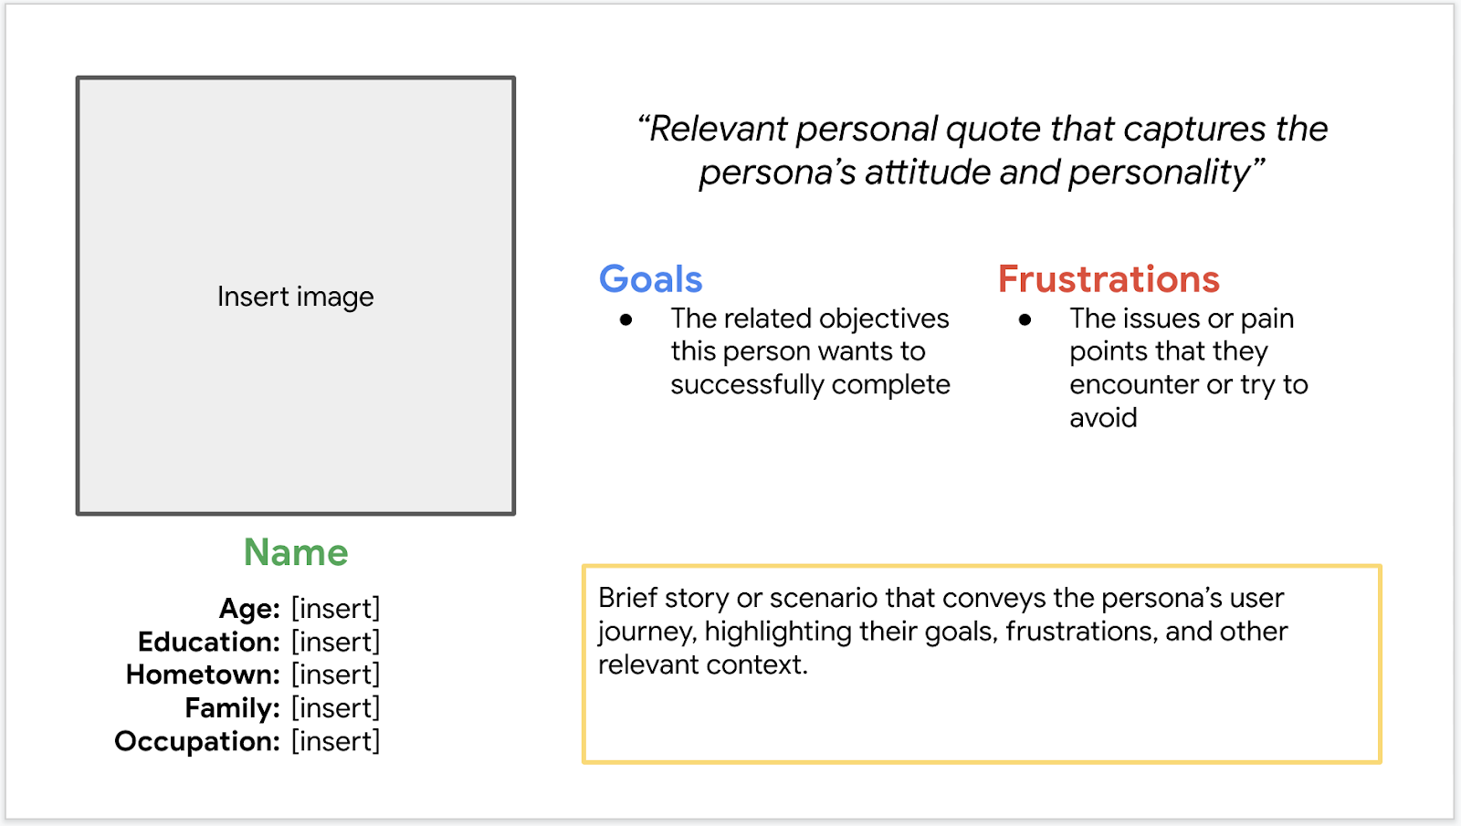
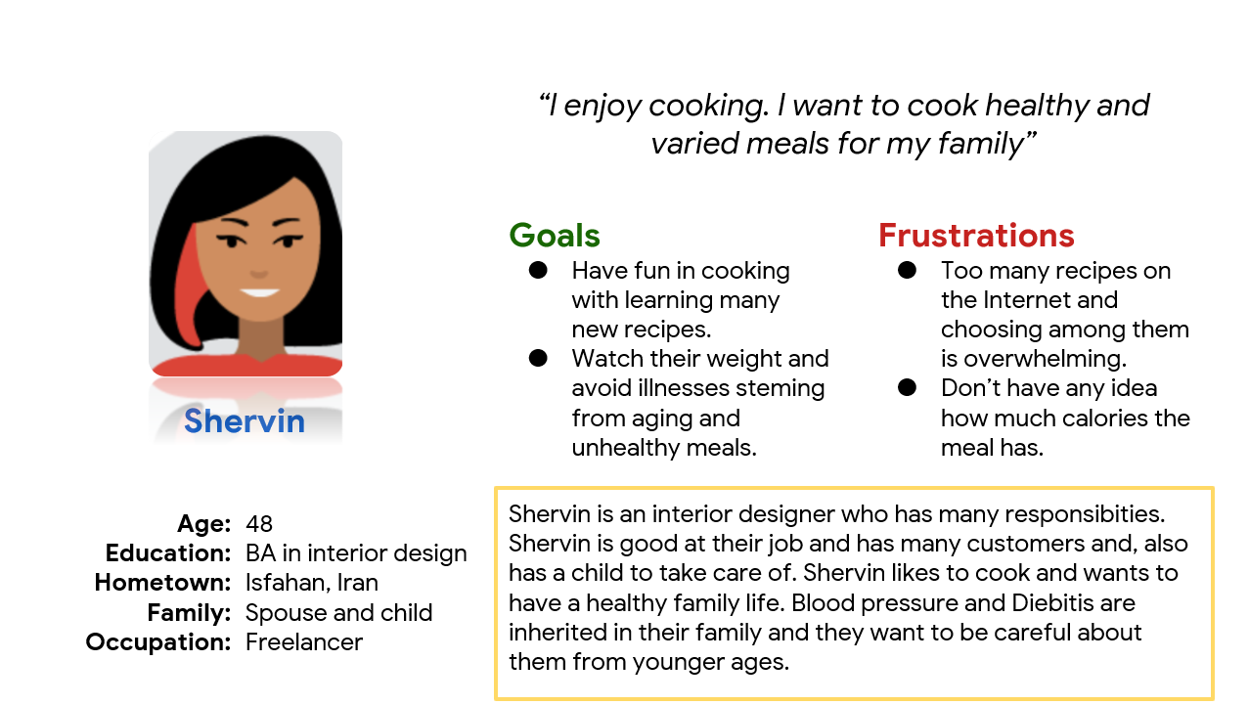
Persona 1: Shervin
Problem statement:
Shervin is an interior designer who needs learning new and healthy recipes because they concern about inherited illnesses in their family and want a healthier life style for their family.

Slide 8
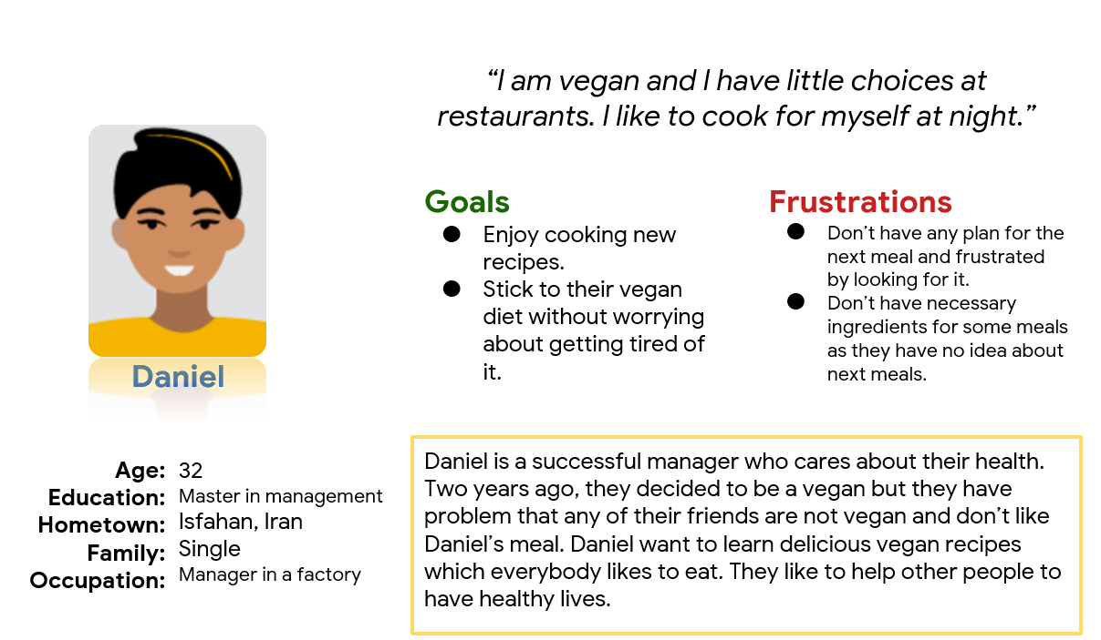
Persona 2: Name
Problem statement:
Daniel is a manager who needs new and delicious vegan recipes because they care about their health and want to stick to their vegan diet.

Slide 9
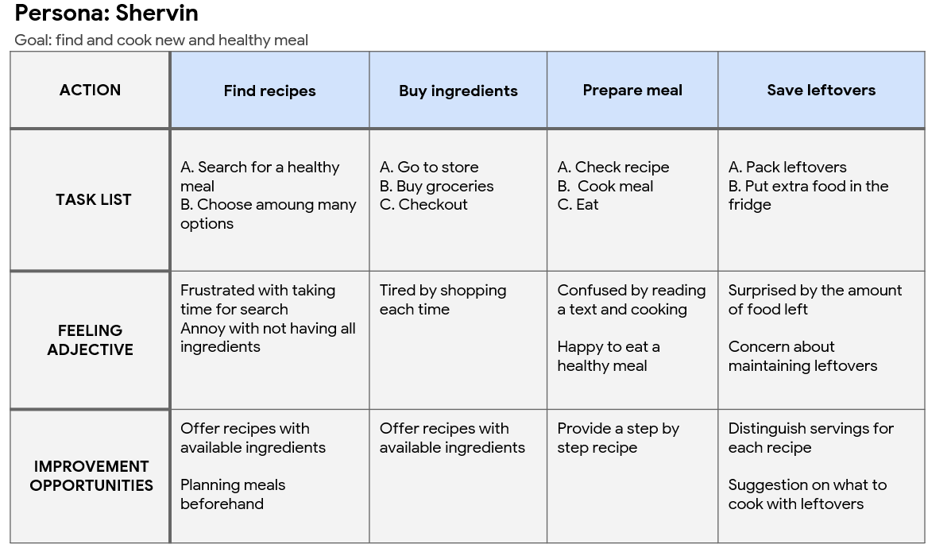
User journey map

Slide 10
Starting
the design
Digital wireframes
Low-fidelity prototype
Usability studies

Slide 11
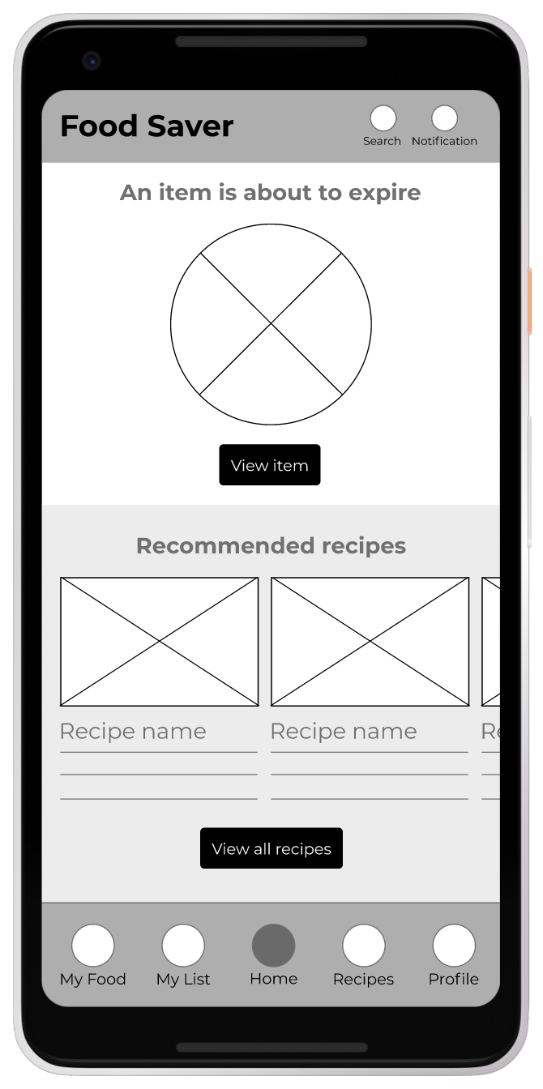
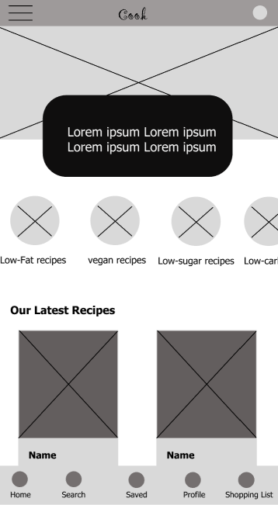
Digital wireframes
Digital wireframes
After ideating and drafting some paper wireframes, I created the initial designs for the cooking app. These designs focused on classification of foods and filtering to help users find the best recipes based on their diets or restrictions.
Insert first wireframe example that demonstrates design thinking aligned with user research
Classification of recipes for quick access
Easy access to app features from global navigation

Slide 12
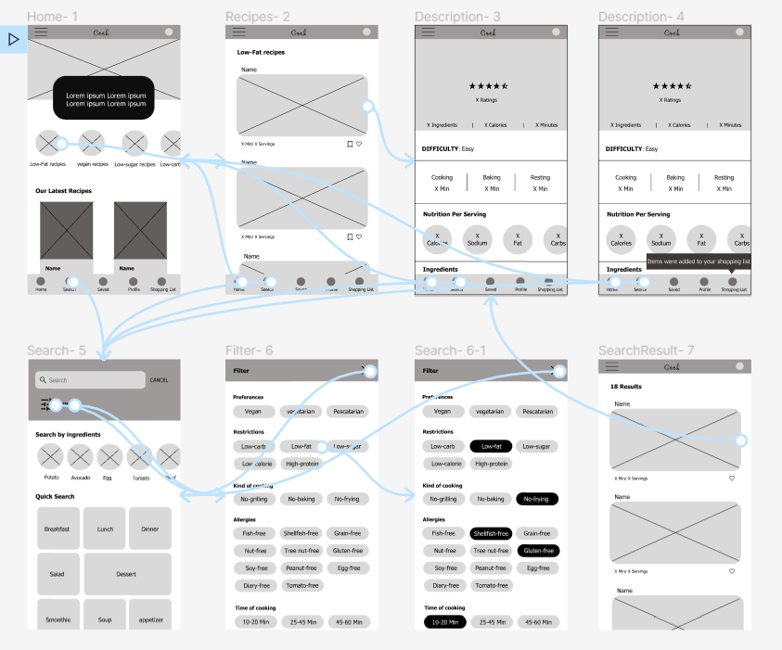
Low-fidelity prototype
To prepare for usability testing, I created a low-fidelity prototype that connected the user flow of finding a recipe based on classified recipes ,or filtering to find the best fit and adding ingredients to shopping list.
View Cooking app's low-fidelity prototype
Screenshot of prototype with connections or prototype GIF

Slide 13
Usability study: parameters
Study type:
moderated usability study
Location:
Iran, remote
Participants:
5 participants
Length:
30-45 minutes

Slide 14
Usability study: findings
These were the main findings uncovered by the usability study:
1
2
3
Recipes
Quick access
Servings
People want broader range of restrictions like kind of cooking in the filter section.
People want to have quick access to their previous used recipes.
People want to be able to change the number of servings and see the amount of ingredients they need for that number.

Slide 15
Refining
the design
Mockups
High-fidelity prototype
Accessibility

Slide 16
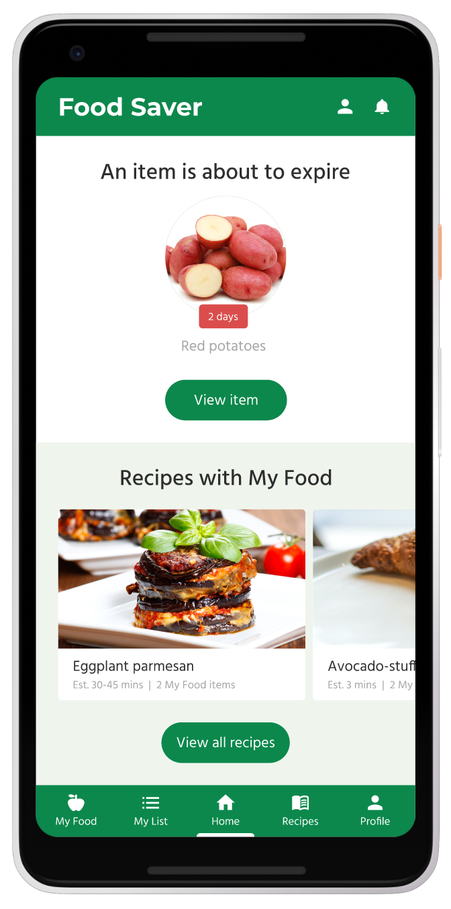
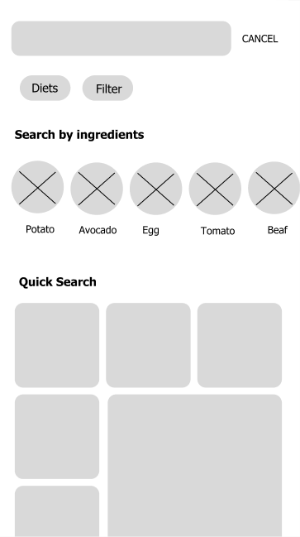
Mockups
Before usability study
After usability study
Based on the insights from the usability studies, I applied design changes like changing the layouts and labels of the search part.

Slide 17
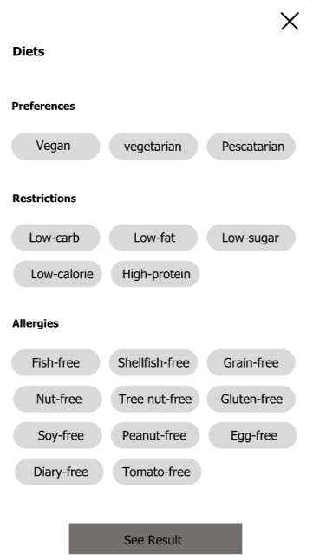
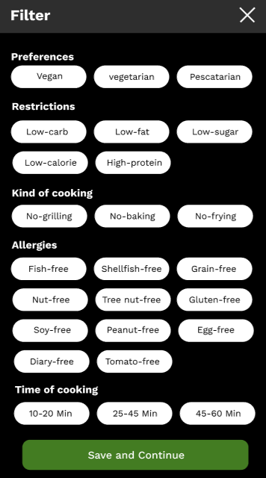
Mockups
Before usability study
After usability study
Also, I expanded the categories of filter in the filter section.
Mockup 1 after

Slide 18
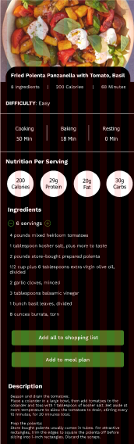
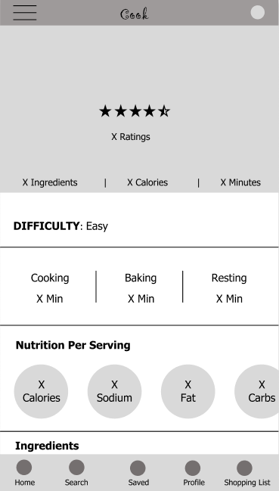
Before usability study
After usability study
Mockups
Additional design change included adding an option to change the number of servings and see the amount of ingredients based on those changes.
Mockup 2 before
Mockup 2 after

Slide 19
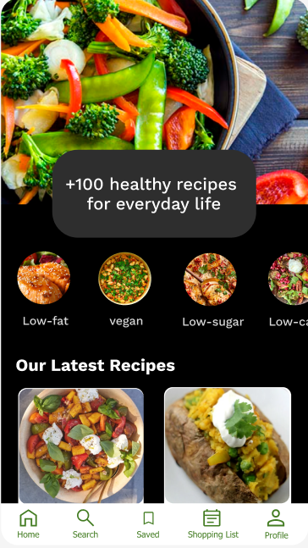
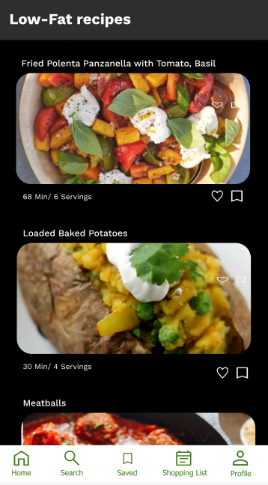
Mockups
Main mockup screen for display
Main mockup screen for display
Main mockup screen for display
Main mockup screen for display

Slide 20
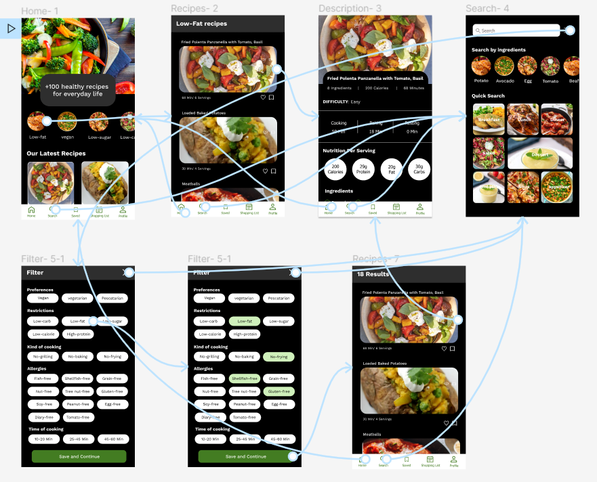
High-fidelity prototype
The high-fidelity prototype followed the same user flow as the low-fidelity prototype, including design changes made after the usability study.
View Cooking app’s high-fidelity prototype.
Screenshot of prototype with connections or prototype GIF

Slide 21
Accessibility considerations
1
2
Clear labels for interactive elements that can be read by screen readers.
Avoiding heavy text and
using icons for users with
visual impairment.

Slide 22
Responsive Design
Information architecture
Responsive design

Slide 23
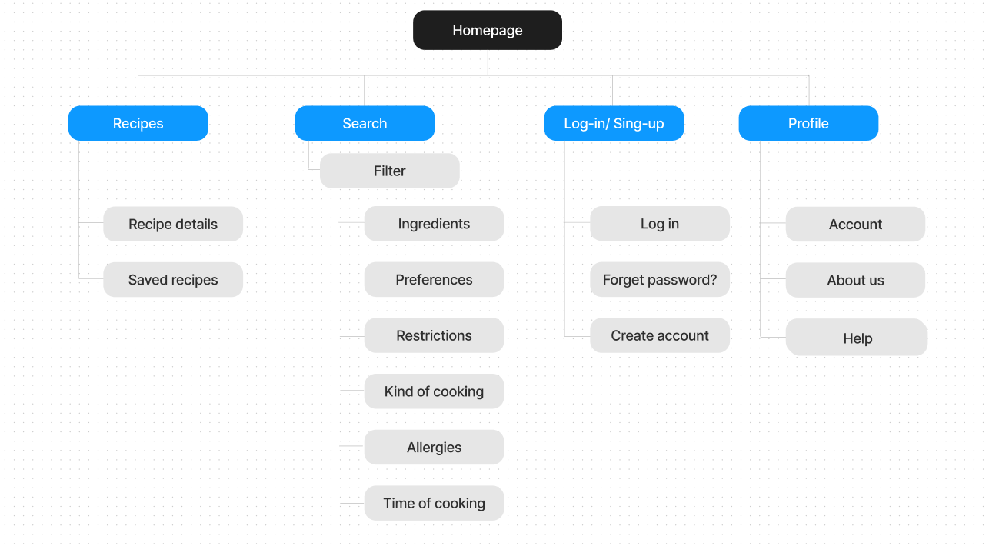
Sitemap
With the app designs completed, I started work on designing the responsive website. I used the cooking app sitemap to guide the organizational structure of each screen’s design to ensure a cohesive and consistent experience across devices.
Image of sitemap/IA

Slide 24
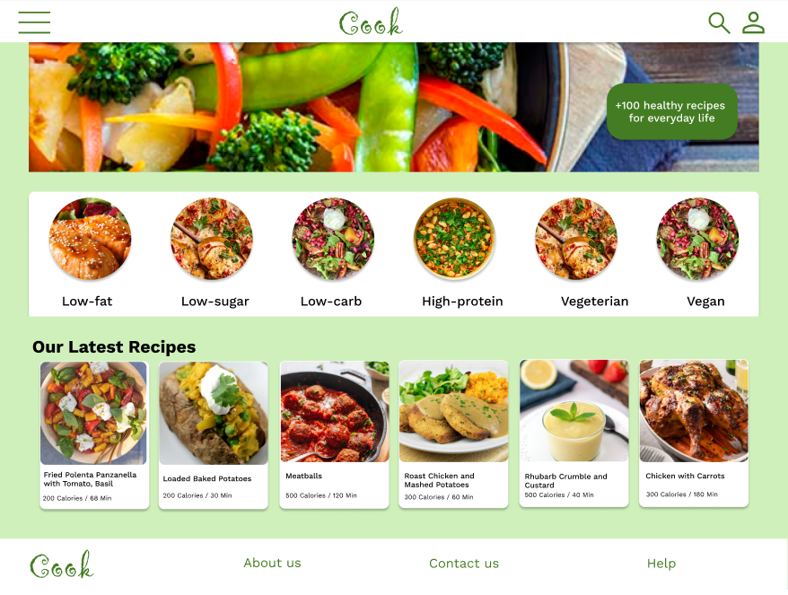
Responsive designs
The designs for screen size variation included mobile, tablet, and desktop. I optimized the designs to fit specific user needs of each device and screen size.
Mobile website
Tablet
Desktop

Slide 25
Going forward
Takeaways
Next steps

Slide 26
Takeaways
Impact:
Users shared that the app can help them learn how to cook healthier meals. One quote from peer feedback was that “the cooking app helps bring caring about our health and make it enjoyable to cook and eat varied meals, and at the same time be careful about our health in an easy way.”
What I learned:
I learned that even though the problem I was trying to solve was a big one, diligently going through each step of the design process and aligning with specific user needs helped me come up with solutions that were both feasible and useful.

Slide 27
Next steps
1
2
3
Conduct research on how successful the app is in reaching the goal to help people learn how to cook healthier meals.
Conduct research on how successful the app is in the improvement of people’s health condition based on their diets and restrictions.
Add educational resources for users to learn how their eating habits can affect their health.

